Slide 1
Digital Marketing
Data of the online advertising strategy followed by a company
Project by : Saumya Gupta
DSGOLD: 999294
Email: Saumyaguptaalld@gmail.com
zip : two files - pdf file of the code transcript, PowerPoint Presentation on your analysis based on the insights that you obtained.

Slide 2
General details and dataset processing
Online advertising performance by advertising firm ‘A’ for company ‘X’
Campaign period : 1-04-2020 to 30-06-2020
Number of features: 12
Number of observations: 15408
Missing value only in ‘placement’ feature, with no of missing values= 413, replaced by mode 0 value due to low percentage (2.6% ) of missing values.
Unique values of features mapped from categorical to numerical:
‘Month’ : April: 4, May: 5, June:6
‘Campaign_number’: camp1: 1, camp 2: 2, camp 3: 3
‘User_engagement’: High : 3, Medium: 2, Low: 1
‘Placement’: abc, def, ghi, mno,jkl changed from dtype: Object to dtype: string
Creating date in DD-MM-2020 format and dropping individual month and day columns as they will be accessible via date column.
Arranging date column as the 0th column
Creating a new dataset post the above changes “Final_processed_data.csv” for further insights.

Slide 3
Metrics | Data type | No of values | No of missing values | remark
Month, Day | Object, int64 | 15408 | 0 | Month and day of advertisement campaign
Campaign | Object | 15408 | 0 | Type of campaign in order to segment and target specific groups
User engagement | Object | 15408 | 0 | Level of engagement of users by the advertising campaign
banner | Object | 15408 | 0 | Size of advertisement
placement | Object | 14995 | 413 | Publisher space where ad is served without disclosing names of publishers
displays | Int64 | 15408 | 0 | No of ads during campaign period
cost | Float64 | 15408 | 0 | Price paid by A to serve ads to publisher(placement cost of advertisement)
clicks | Int64 | 15408 | 0 | No of clicks during campaign
Revenue | Float64 | 15408 | 0 | Price paid by X to A for clicks generated through campaign

Slide 4
Metrics | Data type | No of values | No of missing values | remark
Post click conversion | Int64 | 15408 | 0 | Number of on-site transactions occurred within next 30 days after the user clicked on advertisement
Post click sales_ammount | Float64 | 15408 | 0 | Monetary value of on site transaction within 30 days after user clicked on advertisement

Slide 5
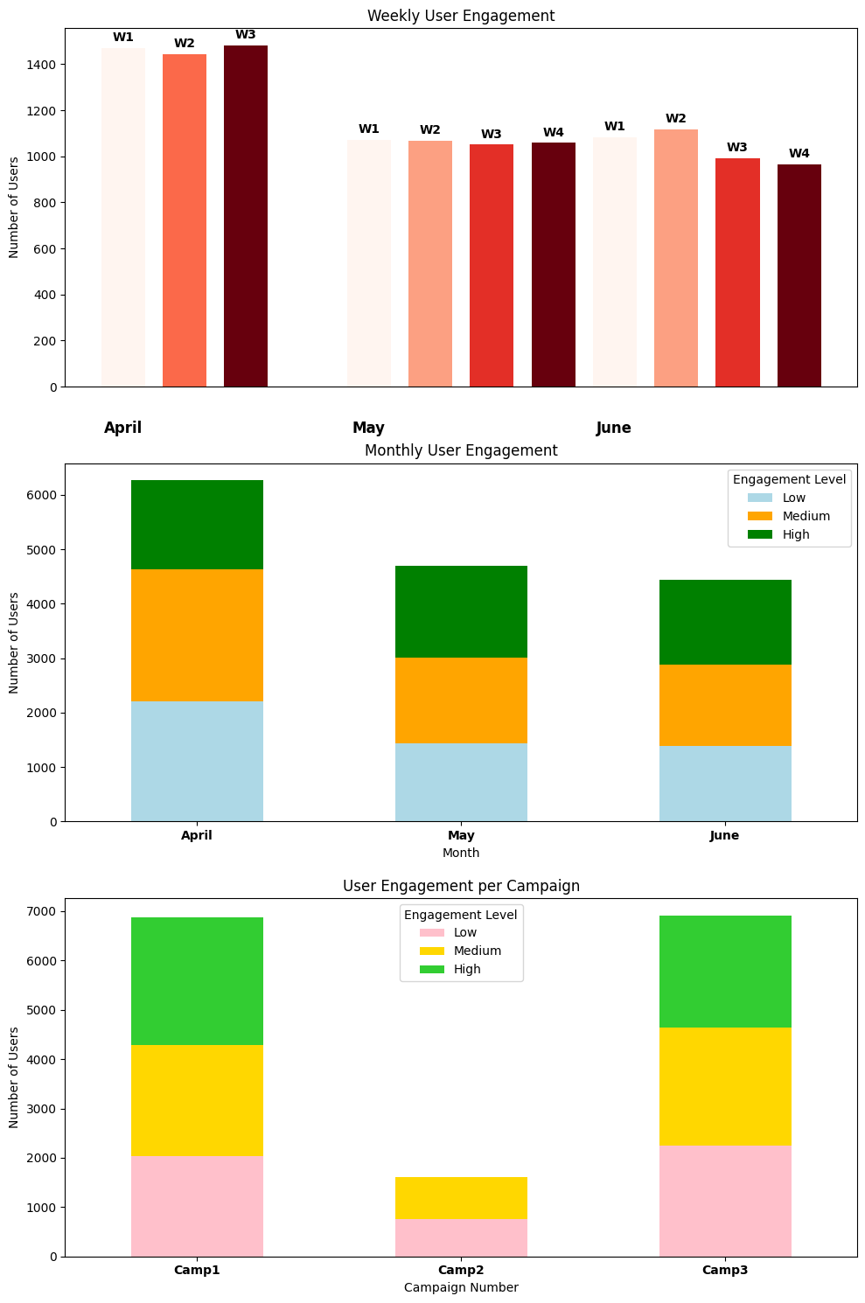
1. What is the overall trend in user engagement throughout the campaign period?
Three types of analysis is performed to analyze trend
Weekly
Monthly
Overall trend weekly wise :
User engagement dropped after April and did not recover to April’s level in May or June.
Insights from weekly user engagement through out the campaign period:
The highest user engagement observed in the Months of April for the 3rd Week.
All other higher engagement peaks also occur in the month of April.
The engagement for the month of May seem to be nearly consistent over the weeks .
While the highest engagement occurred in the 2nd week of June.

Slide 6
1. What is the overall trend in user engagement throughout the campaign period?
Two types of analysis is performed to analyze trend
Weekly
Monthly
Overall trend Monthly wise :
The high engagement segment is maintained for all months suggesting a stable core audience.
Insights from Monthly user engagement through out the campaign period:
Peak user engagement in April and dropped in May and June.
Decline in May and June is evident for all engagement levels( low, medium, high)
Engagement levels in June stayed flat compared to May and displayed no recovery after the initial drop in engagement levels.

Slide 7
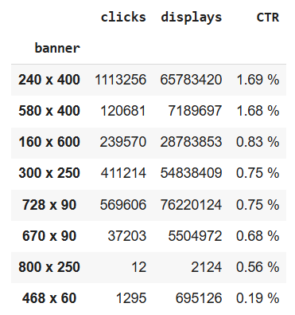
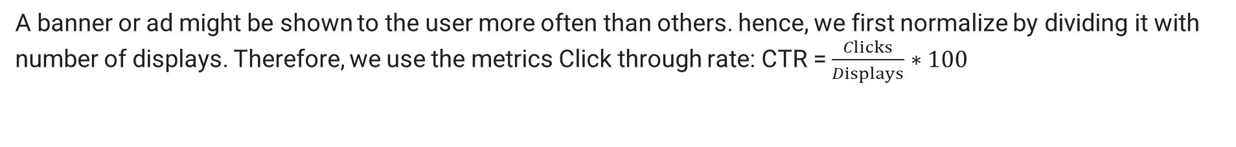
2. How does the size of the ad (banner) impact the number of clicks generated?
A banner or ad might be shown to the user more often than others. hence, we first normalize by dividing it with number of displays. Therefore, we use the metrics Click through rate: CTR = $\frac{Clicks}{Displays}∗100$
Wider banners tend to perform better in terms of number of clicks generated.
2. Higher CTR for 240x400 and 580x400 indicate better clicks and banner visibility for users.
3. While the taller banners seem to perform comparitively low in terms of clicks as seen for 728x90, 670x90, 800x250 and 468x60.

Slide 8
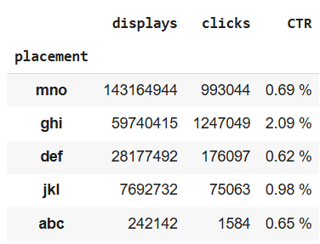
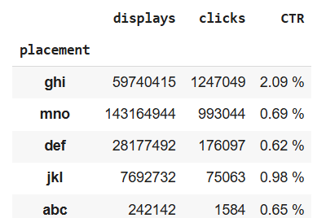
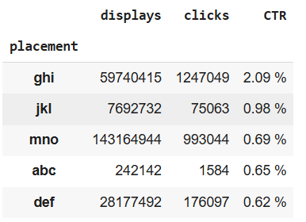
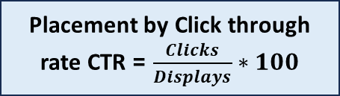
3. Which publisher spaces (placements) yielded the highest number of displays and clicks?
Placement by Click through rate CTR = $\frac{Clicks}{Displays}∗100$
Placement by displays
Placement by clicks
While the ‘ghi’ placement has the highest CTR of 2.09% making 'ghi' a clear choice for yielding higher clicks per display
Highest number of displays: 'mno'
Highest number of clicks: 'ghi'

Slide 9
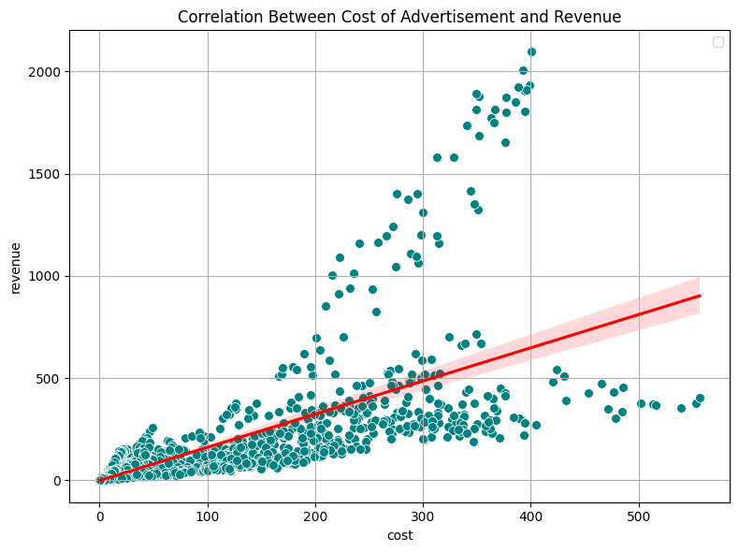
4. Is there a correlation between the cost of serving ads and the revenue generated from clicks?
Correlation between cost and revenue: 0.761
Correlation value = 0.761, which is close to +1 means a strong positive correlation (higher advertisement cost leads to higher revenue).
The plot quantifies the linear relationship indicating more cost results in more revenue

Slide 10
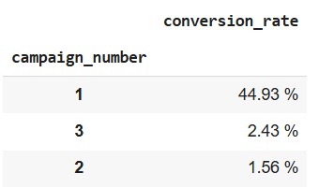

5. What is the average revenue generated per click for Company X during the campaign period?
avg_revenue_per_click = $\frac{Total revenue}{Total clicks}$
Average Revenue per Click: 0.1108 USD
6. Which campaigns had the highest post-click conversion rates?
Campaign 1 had the highest post click conversion rate of about 44%, marginally very high compared to other campaigns that only had 2.4% and 1.5% post click conversion rates for campaign 3 and 2 respectively.

Slide 11
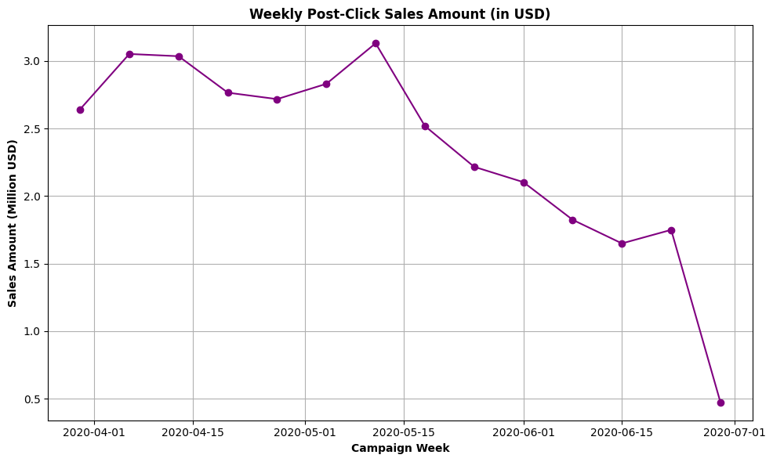
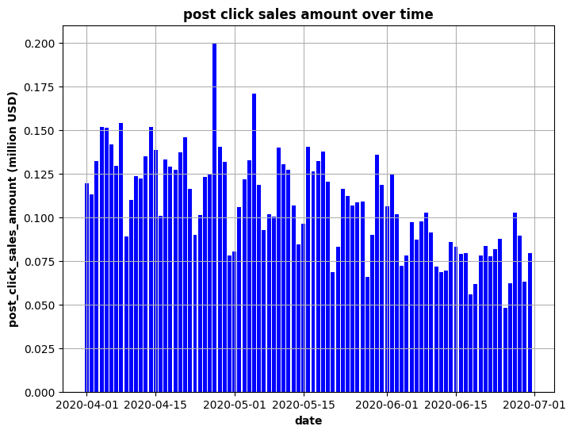
7. Are there any specific trends or patterns in post-click sales amounts over time?
A general declining post-click sales amount over time with the highest post-click sales observed on 11-may week.
Before 15th May the post click sale amount was fluctuating between 2.5 to 3.13 Million USD, post which it declined readily for the following weeks.
maximum post_click_sales_amount is 0.199930318 million USD
The peak sales week was 2020-05-11 with sales amount of $3.13 million.

Slide 12
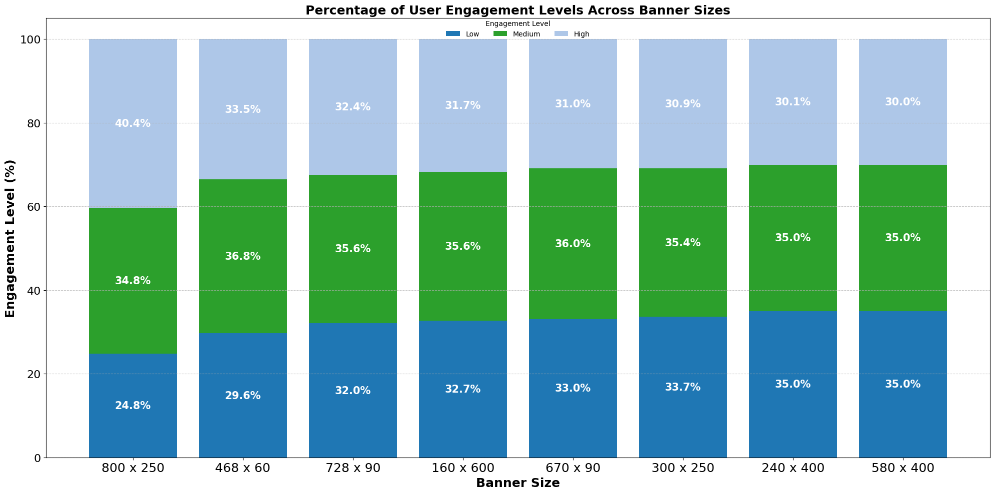
8.. How does the level of user engagement vary across different banner sizes?
As observed from the plot the level of user engagement w.r.t to the banner sizes are plotted above. With the highest engagement of 40.4% for banner size of 800x250.

Slide 13
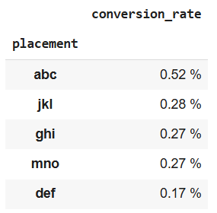
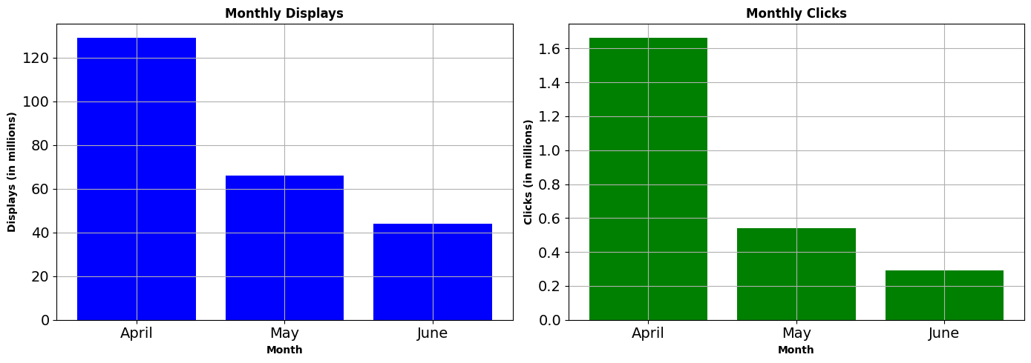
9. Which placement types result in the highest post-click conversion rates?
Top Placement Type is 'abc' with Post-Click Conversion Rate: 52.02%
10. Can we identify any seasonal patterns or fluctuations in displays and clicks throughout the campaign period?
1. The seasonal pattern (month wise), shows decrease in clicks and displays.
2. The lowest engagement reported in June.
3. The clicks falling below ~50% of the clicks in April.

Slide 14
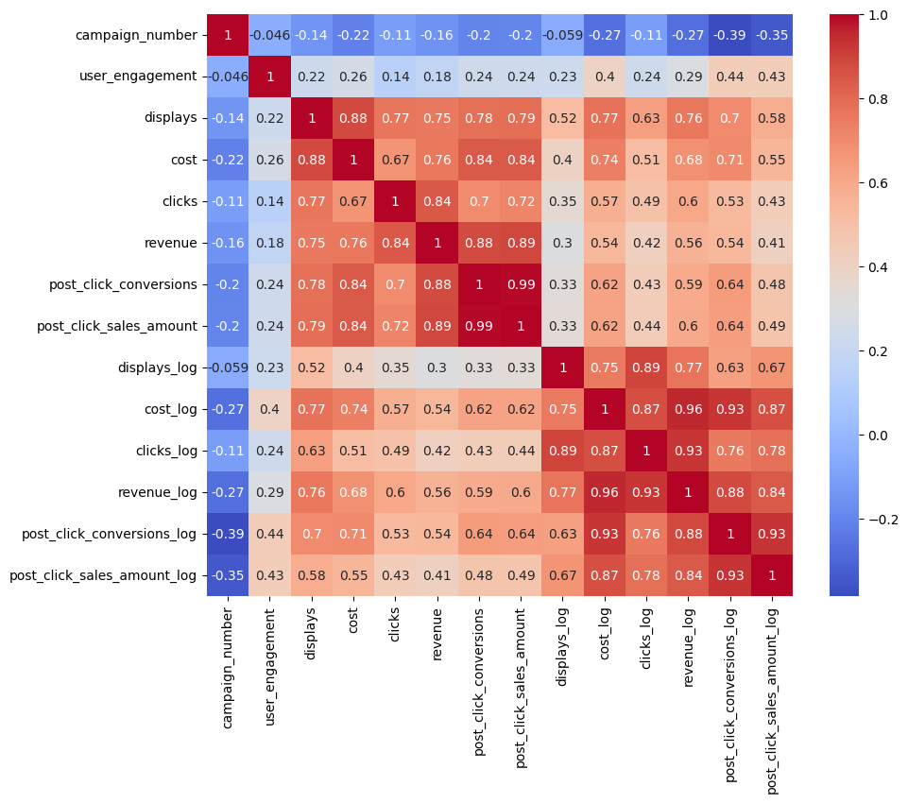
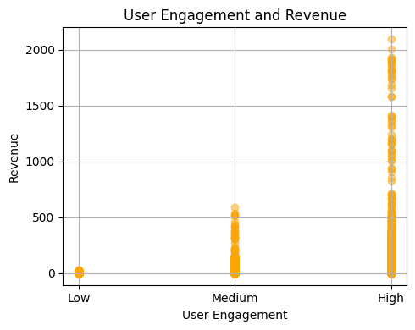
11. Is there a correlation between user engagement levels and the revenue generated?
No, there is no correlation between User Engagement and Revenue.
As the correlation coefficient value is too small (0.18) as shown in heatmap on the right.
The bottom plot suggest higher revenue accompanies higher engagement and lower revenue has lower user engagement.

Slide 15
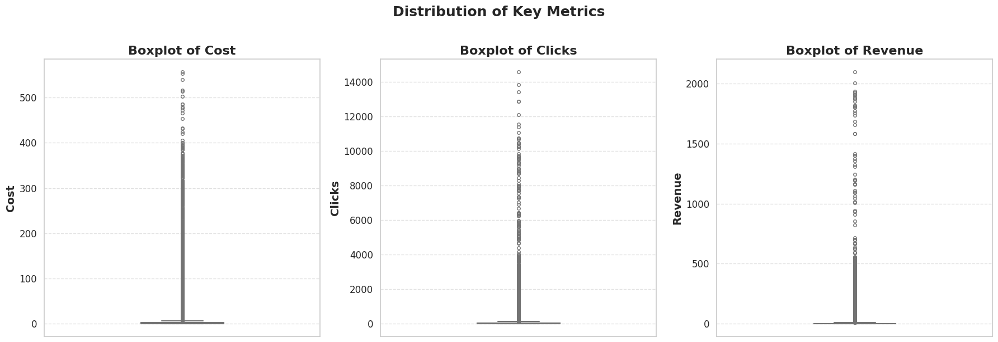
12. Are there any outliers in terms of cost, clicks, or revenue that warrant further investigation?
Box plot of cost, clicks and Revenue
The data is extremely compressed with large number of outliers.
In advertising this data can be a sensitive group of points where one can analyze which campaigns or days had either no clicks or revenue or very high revenue in order to analyze advertising strategies to avoid or consider in future.
Hence instead of removing outliers we can consider a log scale view.
Number of outliers post log scale transformation
Outliers in 'cost_log': 560
Lower bound: -2.26, Upper bound: 4.48
Outliers in 'clicks_log': 48
Lower bound: -2.24, Upper bound: 8.92
Outliers in 'revenue_log': 366
Lower bound: -2.47, Upper bound: 5.17

Slide 16
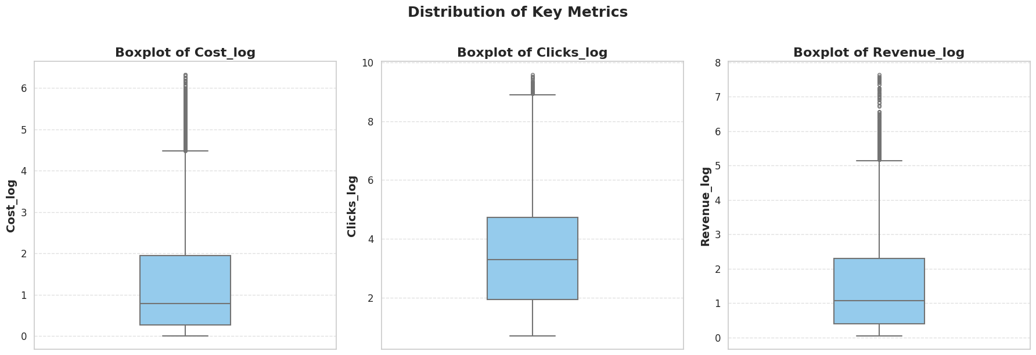
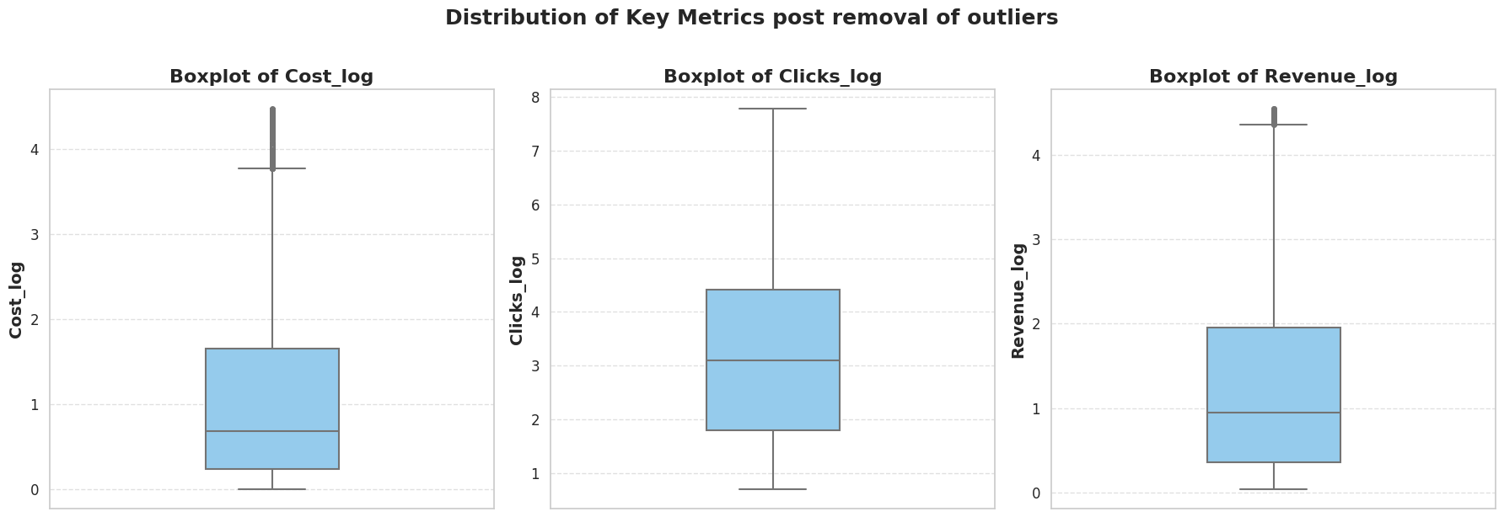
Log scale Box plot
Before outlier removal
Remaining rows after outlier removal: 9598

Slide 17
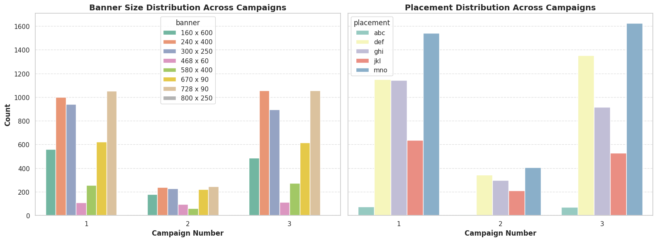
13. How does the effectiveness of campaigns vary based on the size of the ad and placement type?
* Banner size effectiveness:
1. Banner sizes like 240×400 and 580×400 were used more frequently across all campaigns, indicating they might be preferred for their performance or visual appeal.
2. Campaigns 1 and 3 show consistently high usage of these banner sizes, suggesting they contribute positively to engagement.
3. Smaller or uncommon sizes (like 468×60 and 800×250) have limited use, implying lower effectiveness or niche targeting.
* Placement Type Effectiveness
1.Certain placements like ‘mno’ and ‘def’ dominate Campaigns 1 and 3, which may correlate with higher conversions or reach.
2. Placement 'mno' especially stands out in Campaign 3, indicating high effectiveness in that campaign.
3. Campaign 2 shows significantly lower activity across placements, suggesting it may have had lower overall engagement or a smaller target scope.

Slide 18
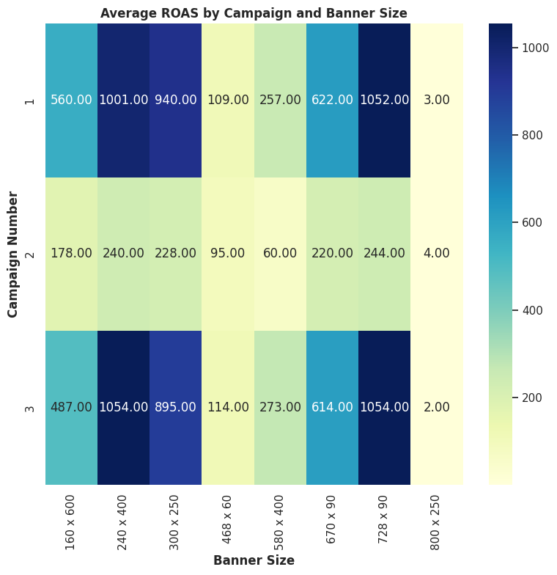
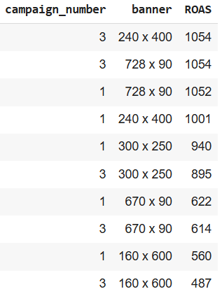
14. Are there any specific campaigns or banner sizes that consistently outperform others in terms of ROI?
Banner size 728x90 (Campaign 1 and 3) and 240x400 (Campaign 3) clearly outperforms all other campaigns or banner sizes

Slide 19
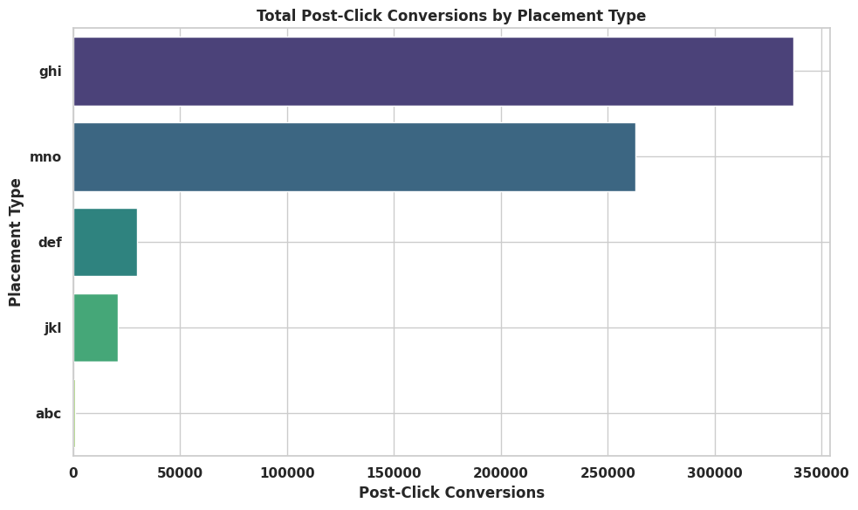
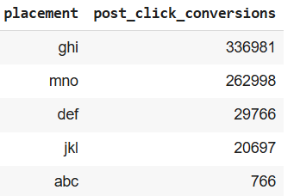
15. What is the distribution of post-click conversions across different placement types?
Highest total post click conversion observed in placement "ghi"

Slide 20
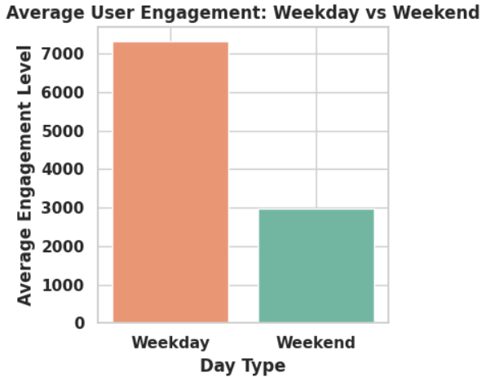
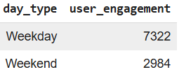
16. Are there any noticeable differences in user engagement levels between weekdays and weekends?
There is clearly higher User engagement on weekdays compared to weekends, approximate difference is engagement level by 4388

Slide 21
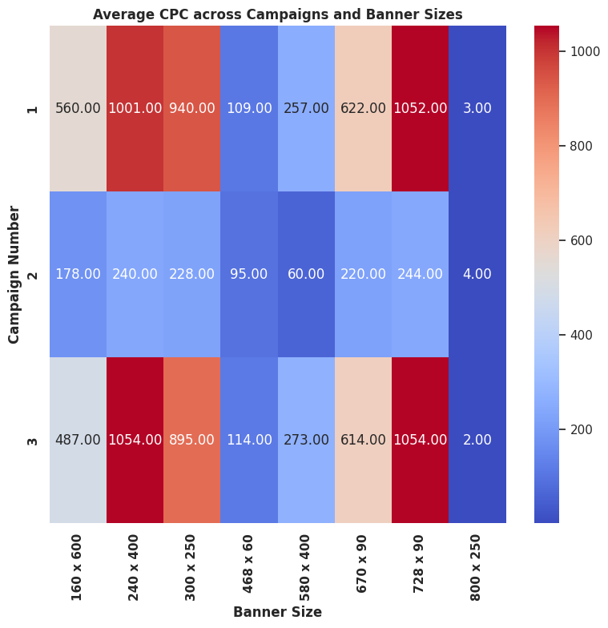
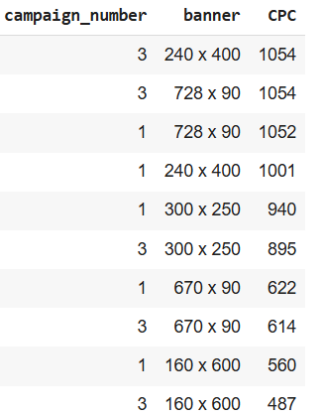
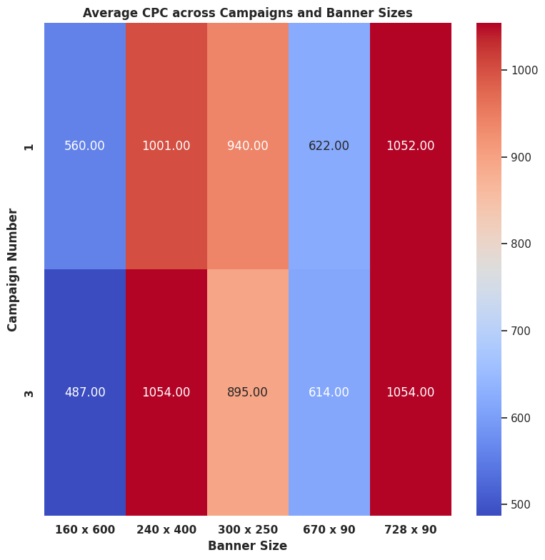
17. How does the cost per click (CPC) vary across different campaigns and banner sizes?
Banner size 728x90 (Campaign 1 and 3) and 240x400 (Campaign 3) have the highest cost per click.
Noticeable, larger banners have high cost per click for both campaign 1 and 3.
The largest banners foe all campaigns donot fall under the high CPC list.
None of the campaign 2 banners make it to the high cost per click value list.
Banners with a low to medium height and width also have high CPC for campaign 1 and 3.

Slide 22
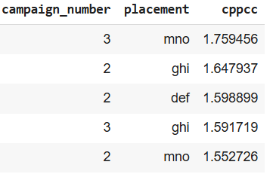
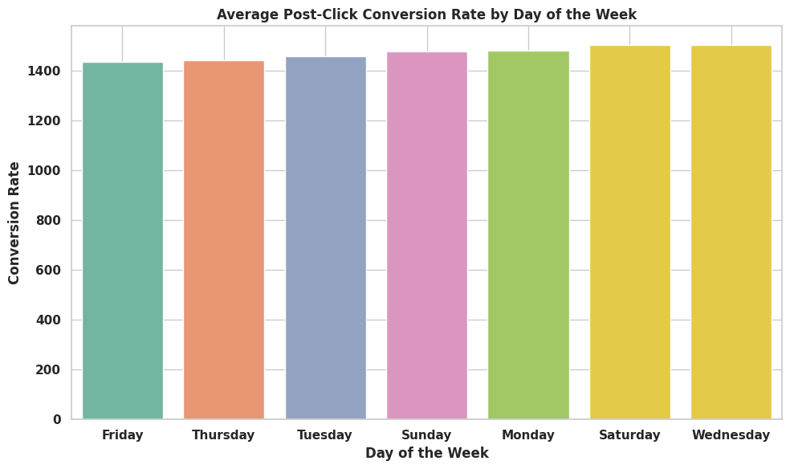
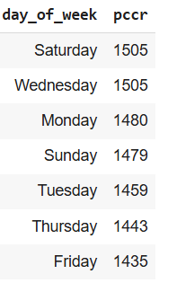
18. Are there any campaigns or placements that are particularly cost-effective in terms of generating post-click conversions?
The "mno" placement for campaign 3 is the most cost effective with highest post click conversions
cppcc (cost per post-click conversion)
19. Can we identify any trends or patterns in post-click conversion rates based on the day of the week?
Highest post click conversions occur on Wednesdays and Saturdays, with least on Fridays
Pccr: post-click conversion rate

Slide 23
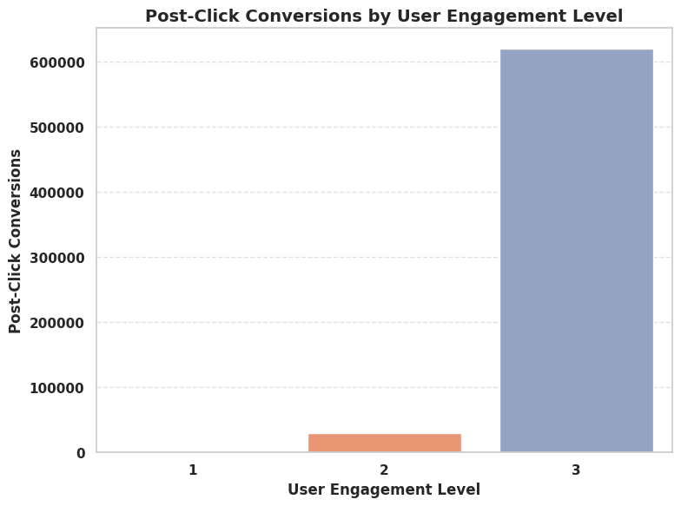
20. Can we identify any trends or patterns in post-click conversion rates based on the day of the week?
1. high engagement users (Level 3) contribute to majority of post-click conversions, indicating they are the most valuable audience for campaign success.
2. Medium engagement users (Level 2) have moderate conversions, showing potential with tailored messaging or remarketing strategies.
3. Low engagement users (Level 1) contribute negligible or no conversions, suggesting low ROI and minimal campaign effectiveness in this segment.

